Slide 1
Amendments to Rule 1210 Toxic Air Contaminant Public Health Risks – Public Notification and Risk Reduction Item 4 November 4, 2021
San Diego County
Air Pollution Control District (District)
Notes:
Good afternoon Chair Vargas, Board members and members of the public, my name is Mahiany Luther and I am a Deputy Director at the District overseeing the Compliance and Engineering divisions.
We are here today to discuss proposed amendments to District Rule 1210 which establishes public notification and risk reduction thresholds and procedures for facilities that create elevated health risks in San Diego County.
We will present recommendations that were developed to improve public health by reducing cancer risk in the region

Slide 2
Background District Rule 1210
California Air Toxics “Hot Spots” Information and Assessment Act (AB2588)
Protects the public’s right to know about air toxic emissions; and
Rule 1210 Implements the “Hot Spots” Program
Defines “elevated health risk”
Requires health risk reductions for facilities with elevated health risks
Establishes public notification and risk reduction procedures
Notes:
Rule 1210 was adopted in 1996 in response to the California Air Toxics “Hot Spots” Information and Assessment Act, or Assembly Bill 2588, which has 2 main goals:
1. Protect the public’s right to know about air toxic emissions and how these emissions can potentially impact public health; and
2. Require health risk reductions for facilities with elevated health risks
District Rule 1210 establishes limits at which facilities must notify surrounding communities of elevated health risks, and reduce those risks . It also establishes procedures for public notification and risk reduction requirements

Slide 3
Background Rule Development Process
May 2019
Board directed the District to evaluate Rule 1210
Aug. 2019
Second Public Workshop
Mar. 2020
Advisory Committee recommendations
Jul. 2020
District requested an extension
Jan. 2020
First Public Workshop
Notes:
The rule development process for Rule 1210 was initiated in May of 2019 when Supervisor Fletcher, under the former Governing Board, proposed to evaluate the existing cancer risk reduction threshold under Rule 1210.
Currently Rule 1210 requires risk reductions when the cancer risk from a facility is equal to or greater than 100 in a million.
This existing threshold is ineffective for the region since it currently does not apply to any facilities in San Diego County
The former District Board supported the recommendation made by Supervisor Fletcher and directed staff to return to the Board with a proposal for Rule 1210 no later than April of 2020.
The District conducted public workshops in August of 2019 and in January of 2020 to discuss draft proposals for Rule 1210
In March of 2020, the District Advisory Committee (under the previous Governing Board) was asked to consider supporting proposed amendments to Rule 1210, which included reducing the cancer risk reduction threshold from 100-in-1-million to 10-in-1-million. The Advisory Committee recommended further analyses, and for the District to return to the Board with proposed rule amendments in about one year.
As recommended by the advisory committee, in July of 2020, the District returned to the Board to request an 18-month extension, which was approved

Slide 4
Background Understanding Cancer Health Risks
Calculated based on scientific data established by the Office of Environmental Health Hazardous Assessment (OEHHA)
OEHHA’s mission is to protect public health and the environment through scientific evaluations
Represents the highest health risk for an individual living, working, or attending a school near a source
Estimates the likelihood that an individual will develop cancer
Expresses the probability of occurrence as chances in million
Notes:
Before we discuss the proposal for rule1210, we would like to go over what the cancer risk calculated under rule 1210 represents
The cancer risk is based on scientific health data established by the Office of Environmental Health Hazard Assessment (or OEHHA), that establishes that the pollutants emitted by facilities subject to Rule 1210 can create an increased cancer risk
OEHHA’s mission is to protect public health and the environment through scientific evaluations
The cancer risk represents the highest risk for an individual living, working, or attending a school near a facility that emits toxic pollutants
It estimates the probability that an individual will develop cancer as chances in a million. As an example, a cancer risk of 100 in a million indicates that a person has an additional risk of 100 chances in a million of developing cancer during their lifetime
Cancer risks calculated under Rule 1210 can be compared to the overall risk of cancer in the general U.S. population, which is about 250,000 cases for every one million people. This estimated risk includes all external factors that contribute to cancer risk, such as air pollution, genetics and lifestyle choices, like diet and smoking
https://oehha.ca.gov/media/downloads/risk-assessment/document/hrsguide2001.pdf

Slide 5
Rule Proposal
Reducing the Cancer Risk Reduction Threshold from 100-in-1-million
to 10-in-1-million
Enhancing Public Notification and Risk Reduction Procedures
Notes:
The rule amendments being proposed today include 2 main revisions:
Reducing the cancer risk reduction threshold from 100-in-1-million to 10-in-1-million
Enhancing the Public Notification and Risk reduction Procedures, including public meeting requirements
In addition to these main changes the rule is being updated to remove outdated language.

Slide 6
Rule Proposal Reducing the Cancer Risk Reduction Threshold
Reducing the Cancer Risk Reduction Threshold from
100-in-1 million to 10-in-1 million
Establish an effective health-protective limit
Align the risk reduction threshold with the public notification threshold, which is currently 10 in one million
Reduce cancer risk in San Diego County
Notes:
The District is proposing to reduce the cancer risk reduction threshold to 10 in a million for the following reasons:
Establish an effective health protective limit. The existing 100 in a million threshold is ineffective for the region since it currently does not apply to any facilities in SD County.
The second reason IS TO reduce cancer risk in SD County. There is scientific health data demonstrating that the pollutants emitted by facilities subject to Rule 1210 contribute to an increased cancer risk, so this proposal includes requirements to reduce cancer risk to the extent feasible
The third reason is to align the cancer risk reduction threshold with the existing public notification threshold, which is currently 10 in one million. It’s not health protective to provide notification to the public about elevated cancer risks and at the same time inform them that the facility is not required to reduce the cancer risk.

Slide 7
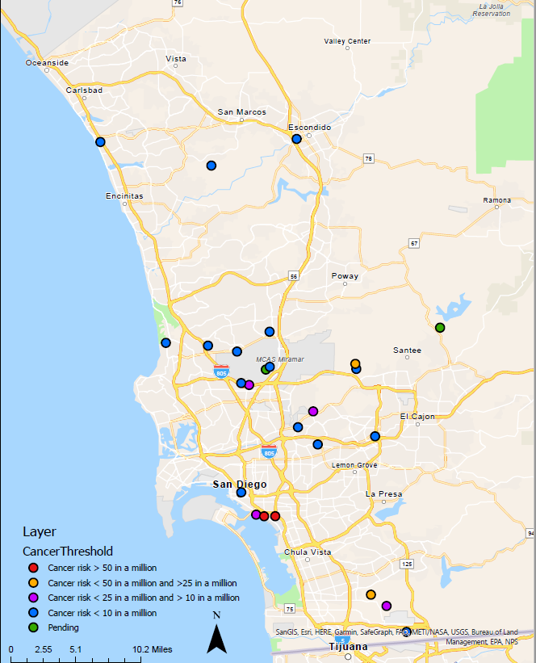
Rule Proposal Reducing the Cancer Risk Reduction Threshold
Cancer Risk Ranges Based on Health Risk Assessment under review | No. of Facilities
Cancer Risk > 50 in a million | 2
50 in a million > Cancer Risk > 25 in a million | 2
25 in a million > Cancer Risk > 10 in a million | 4
Cancer Risk < 10 in a million | 15
Pending Health Risk Assessments | 2
Data subject to change
Notes:
The proposed 10 in a million threshold would potentially affect up to 25 facilities in San Diego County, based on current data. These facilities are shown on this map
This map also shows the estimated cancer risks based on the Health Risk Assessments that were conducted by these facilities. Based on current data, there are
2 facilities have a cancer risk above 50 in a million
2 facilities with a cancer risk between 50 and 25 in a million
And 4 facilities with a cancer risk between 25 and 10 in a million
There are 15 facilities for which the health risk assessments indicate the cancer risk is below 10 in a million, but the District is still reviewing these health risk assessments so this data is subject to change

Slide 8
Rule Proposal Extension Requirements
5 Years
Subsequent 3 Year Extensions
If all technically feasible measures have been installed
Reduce Cancer Risk to 10 in one million
If Toxics Best Available Retrofit Control Technology (T BARCT) has been installed
3 Year Extension
Notes:
Facilities subject to risk reduction requirements would need to reduce the cancer risk to 10 in a million within 5 years
While most facilities can meet this requirement, some facilities might need additional time since technology is still advancing in some sectors
This proposal includes some potential extension allowances as shown on this slide
Facilities that have implemented toxic best available retrofit control technology (or T BARCT) within the 5 year period, might be eligible for a 3-year extension
Implementation of TBARCT requires installation of emission limits or control measures achieved in practice for each source category contributing to the risk exceedances. TBARCT evaluations consider costs and other impacts, such as energy requirements
Subsequent 3 year extensions might be granted if the facility has installed all technological feasible measures to reduce cancer risk. This technology review will be revisited at least every 3 years to ensure all feasible control measures have been implemented at the time of this review
The proposed rule requires the District to conduct a public meeting prior to granting an extension to discuss its preliminary decision and obtain comments from stakeholders.
The District believes that these extension allowances are necessary to reduce health risks to the maximum extent feasible while allowing entities, which benefit our communities, to continue operating. The list of facilities that might be affected by this rule includes landfills, hospitals, university, and manufacturing facilities, and other facilities that provide essential services to the public

Slide 9
Rule Proposal Public Notification & Risk Reduction Protocols
Require proof of distribution of public notification materials
Public meeting requirements
Require public notifications to include clear and readable maps
Notes:
Besides reducing the cancer risk reduction threshold, this proposal includes other revisions such as:
Updating the public notification procedures,
Requiring that all initial public notifications contain clear and readable maps
Requiring proof of distribution of public notification materials by a certain timeframe
currently all public notifications are required to be conducted in other languages based on demographics of each community

Slide 10
Public Notification Requirements
4 Year HRA Cycle
2019 - Health Risk Assessment is Approved
2020
2021
2022
Public Notifications
2021- Biennial Public Notification
2019 - Initial Public Notification
2020 - Risk Reduction Public Notification
Annual Hot Spots Report
2019 Hot Spots Report
2020 Hot Spots Report
2021 Hot Spots Report
2022 Hot Spots Report
Notes:
The proposed rule requires public notification every other year. This slide discusses the proposed biennial public notification requirement and other avenues to notify the public about health risks and risk reduction plants
As previously discussed, Rule 1210 was adopted in response to the Hot Spots Act, which requires facilities that can create elevated health risks to conduct health risk assessments once every 4 years
Health risk assessments quantify the heath risks, and the requirements in Rule 1210 would apply based on those risks
The proposed rule requires public notification every other year because annual notifications would provide the same information to the public multiple times until a new health risk assessment is conducted.
Facilities subject to public notification requirements would also be subject to risk reduction requirements. The District provides public notice of risk reduction plans upon receipt of those plans. Additionally, as required by AB423, all information related to the Hot Spots Program will be posted on the District’s website. The District will also provide updates related to health risks and risk reduction plans when it presents the annual Hot Spots report to this Board. Therefore, in addition to the biennial public notification, there are multiple avenues to notify the public about health risks and risk reduction plans.

Slide 11
Stakeholder Engagement
On July 8, 2021 a draft of Rule 1210 was published
A virtual public meeting was scheduled
District reached out to multiple organizations, community partners, regulated community, and members of the public
On August 5, 2021 virtual public meeting was held
Spanish interpretation services were provided
The meeting is available on the District’s YouTube Channel
Notes:
On July 8, 2021 the District released proposed amendments of Rule 1210 and scheduled a virtual public meeting for August 5
Public meeting outreach was conducted by publishing the meeting notice and draft rule on the District’s website and by reaching out to: permit holders, and about 14,000 e-mail addresses via the District’s GovDelivery email subscription service;
On August 5, 2021 the District conducted a virtual public meeting to discuss the draft rule. Spanish interpretation services were provided during the meeting. Additionally, the meeting was available on the District’s YouTube Channel.
There were 32 attendees in the public workshop. 12 comment letters were submitted resulting in a workshop report that has 85 questions and answers

Slide 12
Today’s Recommendations
Staff Recommendation
Find that an Environmental Review of proposed amended Rule 1210 - Toxic Air Contaminant Public Health Risks – Public Notification and Risk Reduction has been completed in accordance with Section 15187 of the California Environmental Quality Act (CEQA), and that these proposed amendments are exempt from CEQA under Sections 15330, 15301 and Section 15061 subsection (b)(3) of the CEQA Guidelines.
Adopt the resolution entitled: Resolution Adopting Amendments to Rule 1210 – Toxic Air Contaminant Public Health Risks – Public Notification And Risk Reduction, of Regulation XII of the rules and regulations of the San Diego County Air Pollution Control District.
Notes:
Today’s recommendations is to find that the Rule 1210 proposal is exempt from CEQA and adopt amendments to Rule 1210

